Slide 1
Lesson 5 – Code Testing

Slide 2
Lesson goals
What is code testing
Why we need it
How to write tests
Tests and Mocking
Code coverage
Testing methodologies

Slide 3
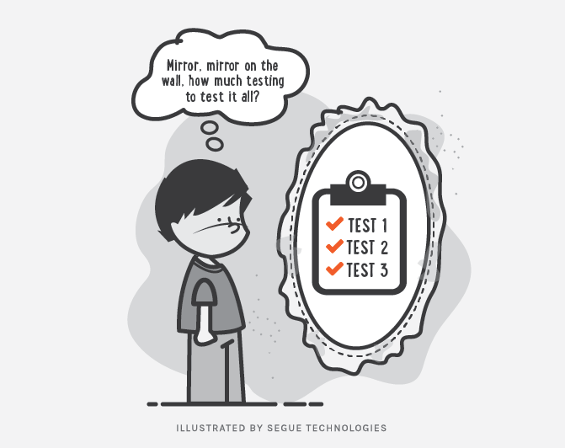
Code Testing

Slide 4
Importance
Scenario : “Let’s make a small fix!!!”

Slide 5
Importance
Scenario : “Let’s make a small fix!!!”
Action: Developer changes a “simple” line of code.

Slide 6
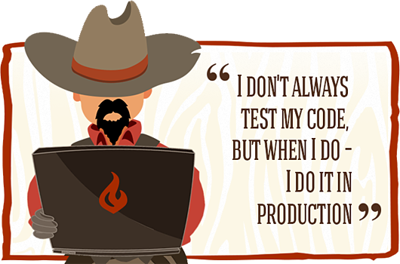
Importance
Scenario : “Let’s make a small fix!!!”
Action: Developer changes a “simple” line of code.
Result: This quick fix solve the problem but broke other parts of the program 😈

Slide 7
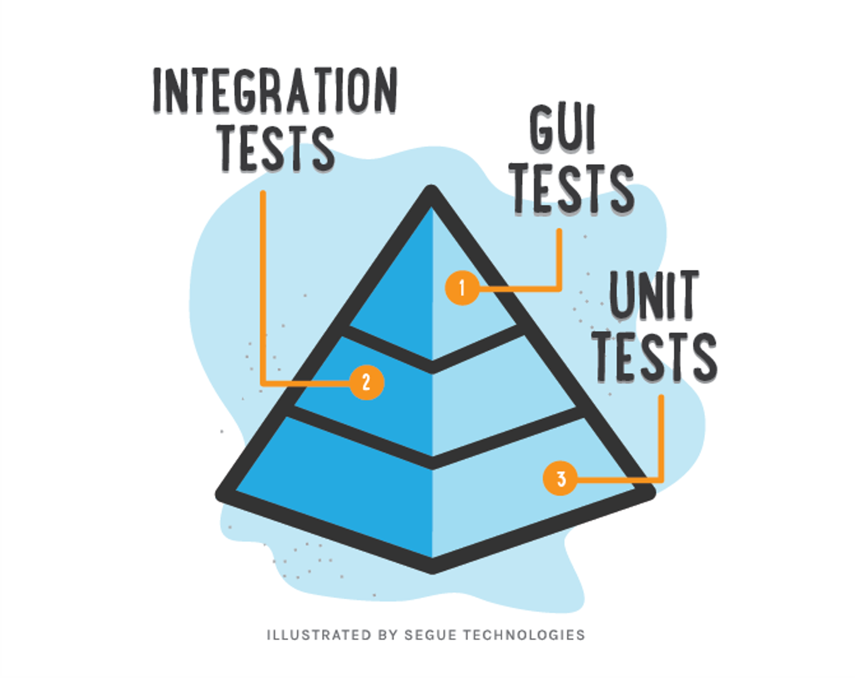
Testing levels aka “Testing Pyramid”
Manual Testing
$$$$
$

Slide 8
Pros vs Cons
Bugs preventing
Easy refactoring
Better code architecture
Documentation
Less debugging cases
Time saver
Money saver
Must have practice for big projects
Guarantee that your code is working as expected

Slide 9
Pros vs Cons
Bugs preventing
Easy refactoring
Better code architecture
Documentation
Less debugging cases
Time saver
Money saver
Must have practice for big projects
Guarantee that your code is working as expected
Needs more time for first coding
Require support
Possible overhead
Hard to write good tests
Hard to apply on legacy code

Slide 10


Testing libraries

Slide 11
Unit testing

Slide 12
Unit Test Example
class Calculator {
int add(int x, int y) {
return x + y;
}
}
import org.testng.annotations.Test;
import static org.testng.Assert.*;
public class CalculatorTest {
@Test
public void adding_two_numbers() {
Calculator calculator = new Calculator();
int actualResult = calculator.add(1, 2);
int expectedResult = 3;
assertEquals(actualResult,expectedResult);
}
}

Slide 13
How to setup & run tests
Setup:
Add test library to project
Run:
Directly from IDE (mostly used)
Via build system (Gradle task verification::test)
CI server to assure that nothing was broken

Slide 14

Working with IDE

Slide 15
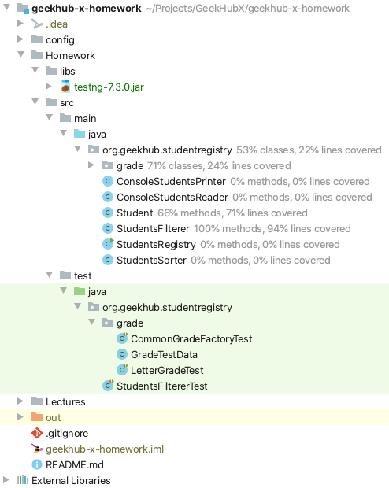
Test Source code convention

Slide 16
Code Convention in Tests
Test of class should be in same package in test source root
Tested class should have same name as tested class with suffix “Test”
Feature to be tested
Should_ExpectedBehavior_When_StateUnderTest
When_StateUnderTest_Expect_ExpectedBehavior
One convention for all tests

Slide 17
Tested method names patterns
Feature to be tested
IsNotAnAdultIfAgeLessThan18
FailToWithdrawMoneyIfAccountIsInvalid
StudentIsNotAdmittedIfMandatoryFieldsAreMissing

Slide 18
Tested method names patterns
Should_ExpectedBehavior_When_StateUnderTest
Should_ThrowException_When_AgeLessThan18
Should_FailToWithdrawMoney_ForInvalidAccount
Should_FailToAdmit_IfMandatoryFieldsAreMissing

Slide 19
Tested method names patterns
When_StateUnderTest_Expect_ExpectedBehavior
When_AgeLessThan18_Expect_isAdultAsFalse
When_InvalidAccount_Expect_WithdrawMoneyToFail
When_MandatoryFieldsAreMissing_Expect_StudentAdmissionToFail

Slide 20
Test results verification
assertEquals(Object o1, Object o2)
assertNotEquals(Object o1, Object o2)
assertTrue(boolean condition)
assertFalse(boolean condition)
assertNull(Object o)
assertNotNull(Object o)
more in org.testng.Assert.*

Slide 21
Test configurations
Usage of @BeforeMethod annotation
Usage of @AfterMethod annotation
public class CalculatorTest {
@Test
public void adding_two_numbers() {
Calculator calculator = new Calculator();
int actualResult = calculator.add(1, 2);
int expectedResult = 3;
assertEquals(actualResult, expectedResult);
}
}

Slide 22
Method that throws exceptions
public class CommonGradeFactory implements GradeFactory { @Override public Grade createGrade(GradeType gradeType, int value) { switch (gradeType) { case LETTER: return new LetterGrade(value); case PERCENTAGE: return new PercentageGrade(value); case GPA: return new GpaGrade(value); default: throw new IllegalArgumentException(); } } }
Expected exception parameter for test method

Slide 23
Which code should be tested by Unit tests?
Yes
Business logic
Everything that contain conditions
No
Working with file system or DB
Working with some external services or internet

Slide 24
What you should not test
Other frameworks or libraries
Trivial code like “get/set”
Code that has non deterministic results (Think random numbers)

Slide 25
What is a good Unit test
Easy to understand
Easy to run
Repeatable
Has one logical assertion
Independent(Isolated)
Incremental
Test single unit
Maintainable
Fast
Informative (in case of fail)

Slide 26
Good practices
Limit bounds test cases (especial for user input)
Reset components before each test
Test success cases and fail cases separately
Dependency injection through constructor

Slide 27
Mocking

Slide 28
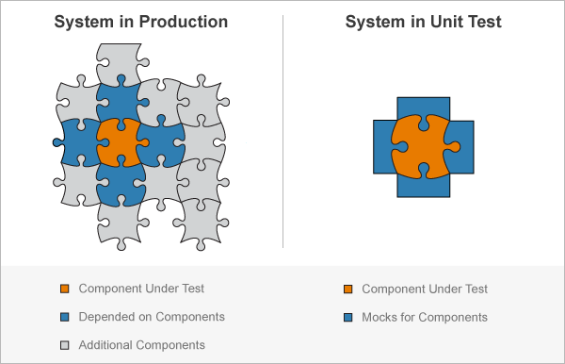
Mock Concept

Slide 29
Mock Types
Stub – do nothing
Mock – perform mocked operations
Spy – real object with mocked operations

Slide 30


Mocking libraries…

Slide 31
What is Mock ?
public interface OperationWithOneArgument {
Number calculate(Number argument);
}
public interface OperationWithTwoArguments {
Number calculate(Number x, Number y);
}
class CalculatorWithOperations {​
​
private final OperationWithOneArgument sqrtOperation;​
private final OperationWithTwoArguments sumOperation;​
​
CalculatorWithOperations(​
OperationWithOneArgument sqrtOperation,​
OperationWithTwoArguments sumOperation​
) {​
this.sqrtOperation = sqrtOperation;​
this.sumOperation = sumOperation;​
}​
​
double add(Double x, Double y) {​
Objects.requireNonNull(x);​
Objects.requireNonNull(y);​
​
return sumOperation.calculate(x, y).doubleValue();​
}​
​
double sqrt(double x) {​
Objects.requireNonNull(x);​
return sqrtOperation.calculate(x).doubleValue();​
}​
}​

Slide 32
Argument matchers
any()
anyInt/String/etc()
any(Class c)
anyCollection/List/Set/Map()
eq()
More in class “org.mockito.ArgumentMatchers‘

Slide 33
AAA (arrange, act, assert) or “given-when-then”
@DataProvider(name = "testAddParameters")
public static Object[][] testAddParameters() {
return new Object[][]{
{1, 2, 3},
{2, 2, 4},
};
}
@Test(dataProvider = "testAddParameters")
public void testAdd(int x, int y, int expectedResult) {
//arrange - test initialisation + stubs/mocks creation
when(sumOperation.calculate(1, 2)).thenReturn(3);
//act - where the operation to be tested is performed
int actualResult = calculator.add(x, y);
//assert - received result assertion + mocks verification
verifyZeroInteractions(sqrtOperation);
assertEquals(actualResult, expectedResult);
}

Slide 34

Code Coverage

Slide 35
Test Driven Development

Slide 36
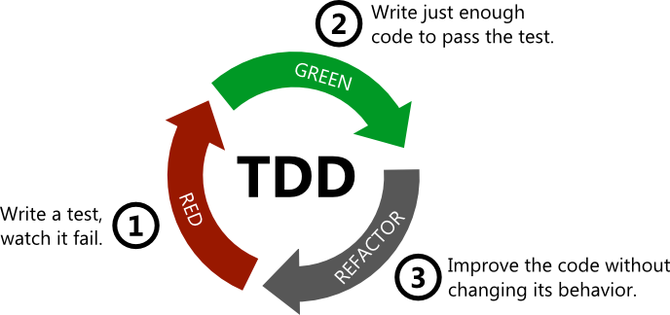
Test Driven Development

Slide 37
Homework
Clean Code: A Handbook of Agile Software Craftsmanship by Robert C. Martin : Chapter 9
Add latest TestNG library to project
Add latest Mockito-core library to project
Write tests on existing code (coverage should be not less than 80%) – pay attention on boundary cases
As a beginning you can follow ideas from code in public repository
Implement flexible architecture in your project by making StudentRegistryTest passed

Slide 38
Useful links
Add custom Library to IDEA
Best practices for unit testing
The Pros & Cons of Test-Driven Development
7 Popular Unit Test Naming
Mockito Annotations

Slide 39

Thanks!
Any Questions?
Or find us in Slack:
@Yaroslav Brahinets
@Vasya Rudas

